Slide 1
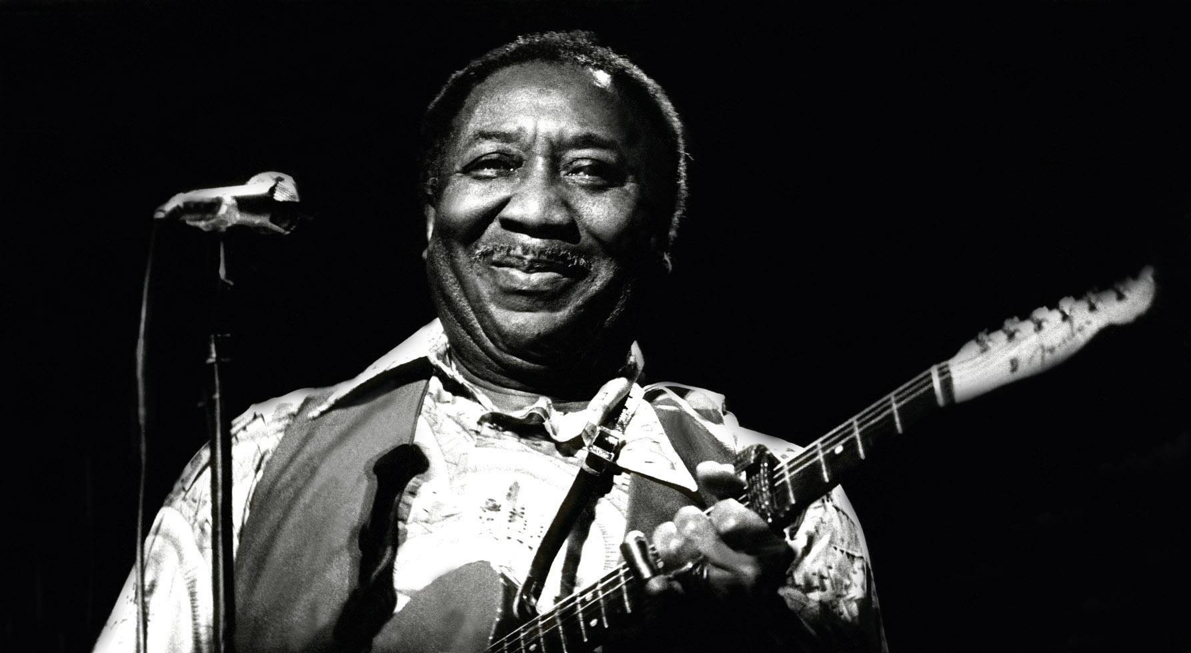
Or: How I learned to stop worrying and love the hippocampus

Slide 2
Hippocampal Contributions to Human Navigation
General structure-function relation?
Specific structure-function relation?
Levels of analysis….
Single-cell recording: place cells, etc.
Voxel-level: Distance coding
Whole-structure level: Spatial navigation
Lesion studies (Habib & Sirigu; HM)
And size of structure? Or, um, grey-matter density?

Slide 3
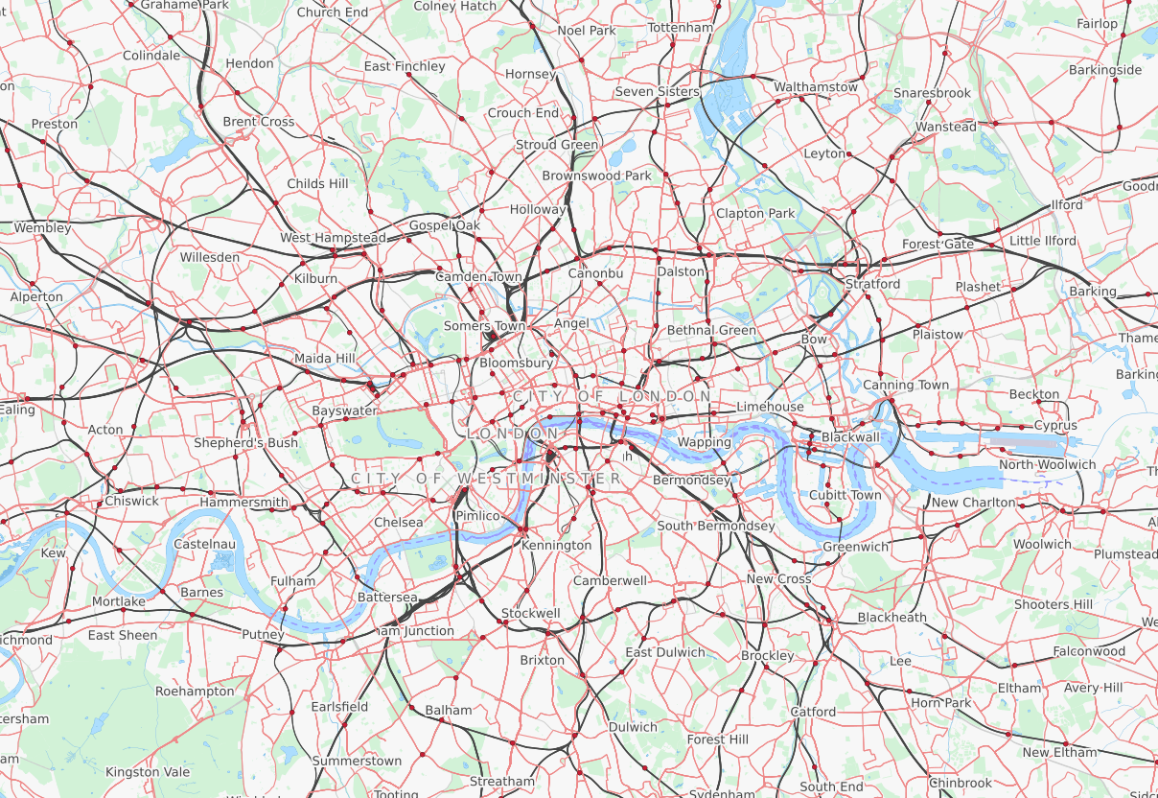
The Knowledge

Slide 4
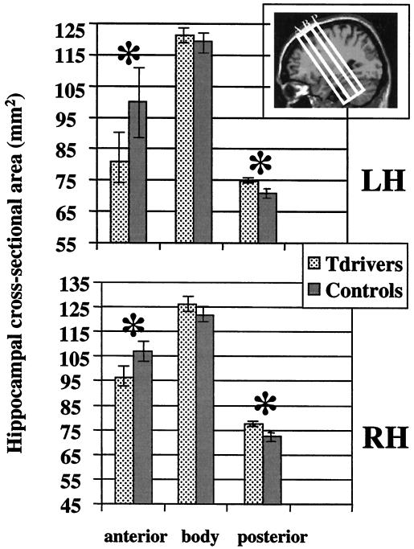
Maguire: Taxi Drivers vs. Normals

Slide 5
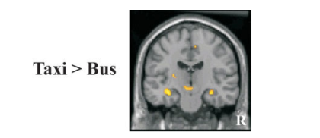
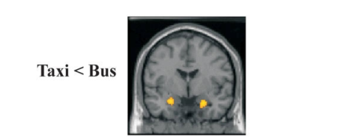
Maguire: Taxi Drivers vs. Bus Drivers - VBM

Slide 6
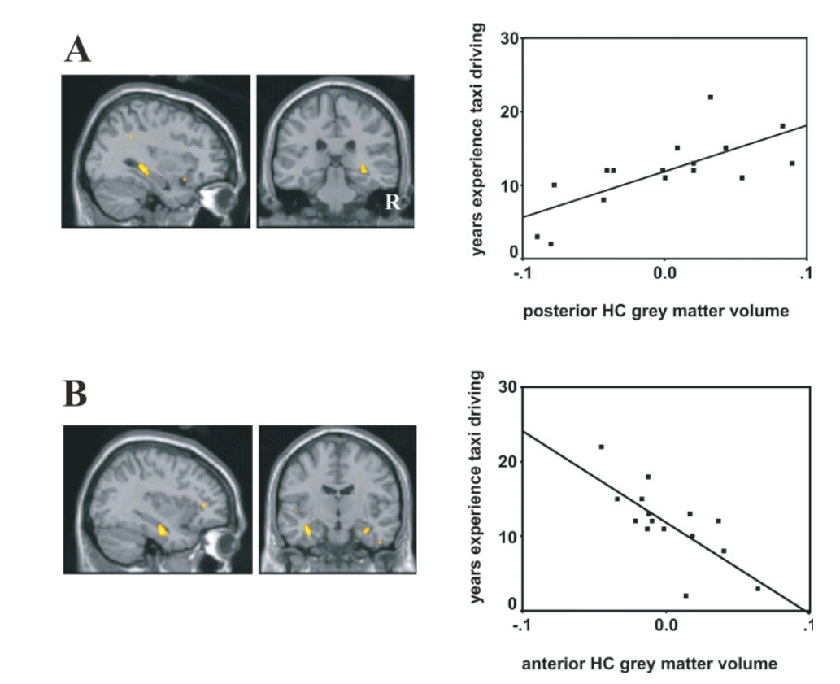
Maguire 2: Taxi Drivers

Slide 7
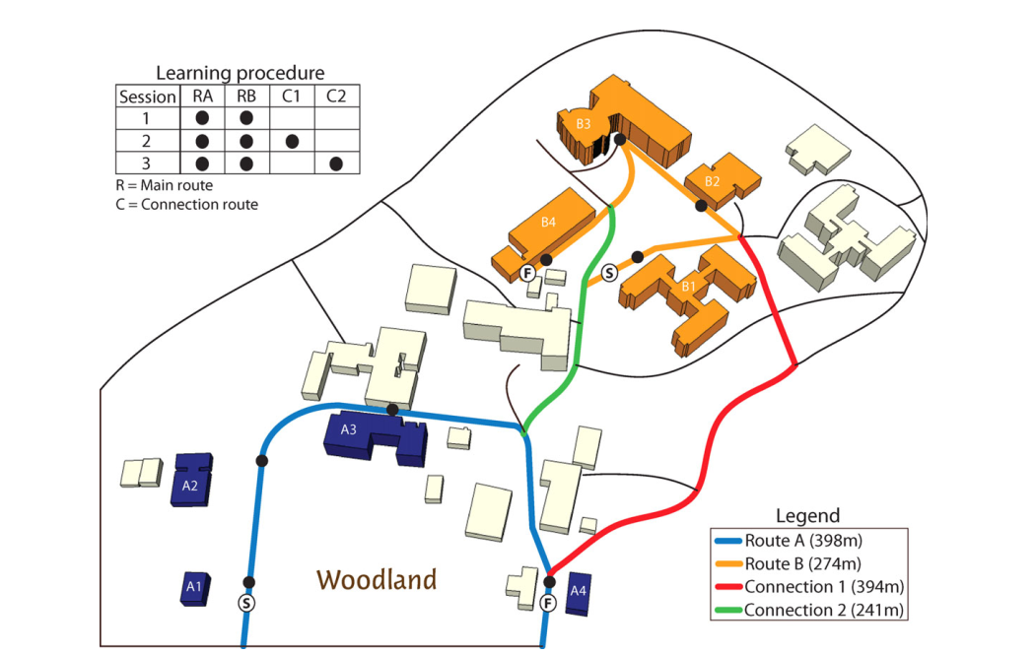
Schinazi: Real world navigation, undergrads

Slide 8
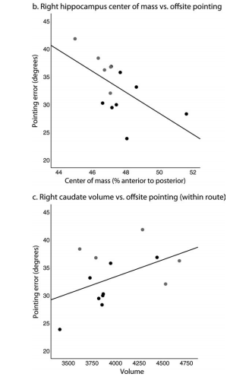
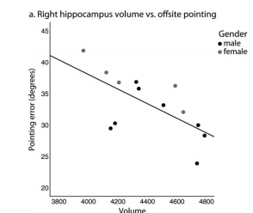
Schinazi: Real world navigation (offsite pointing!)

Slide 9
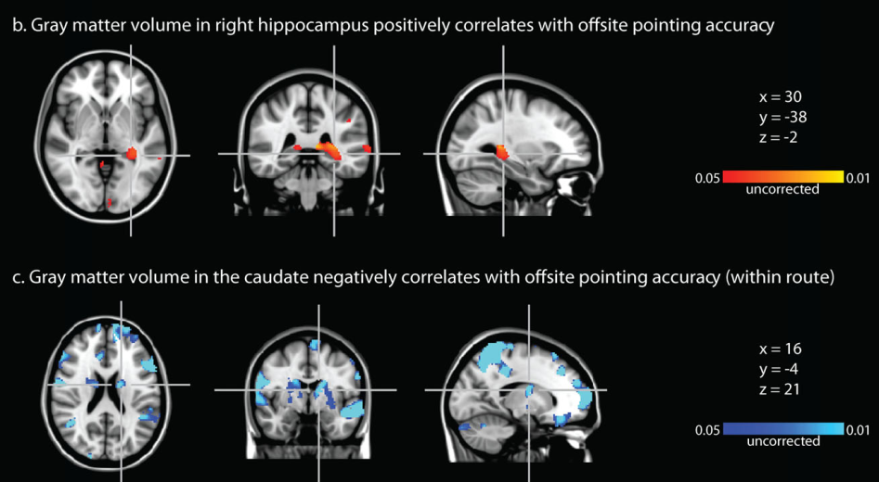
Schinazi: Real world navigation

Slide 10
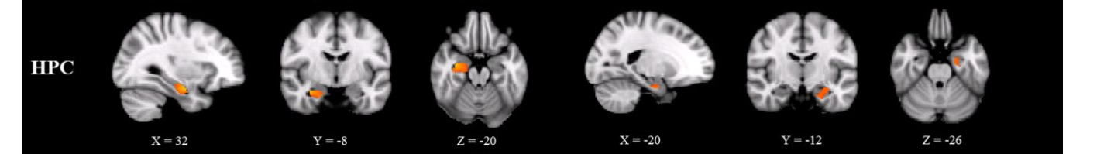
Liu: Self-report
RH
LH

Slide 11
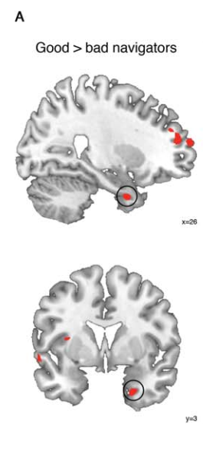
Jenzen: Self-report

Slide 12
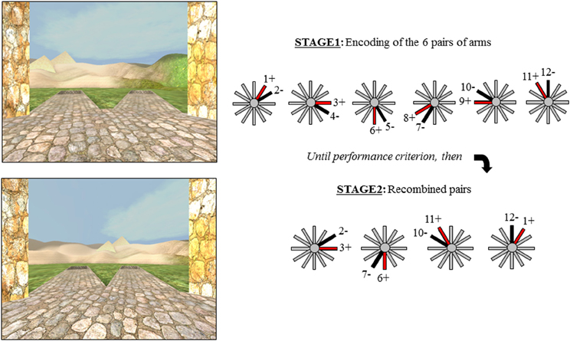
Bohbot: Specifically spatial strategy

Slide 13
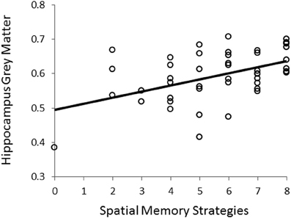
Bohbot: Elderly adults

Slide 14
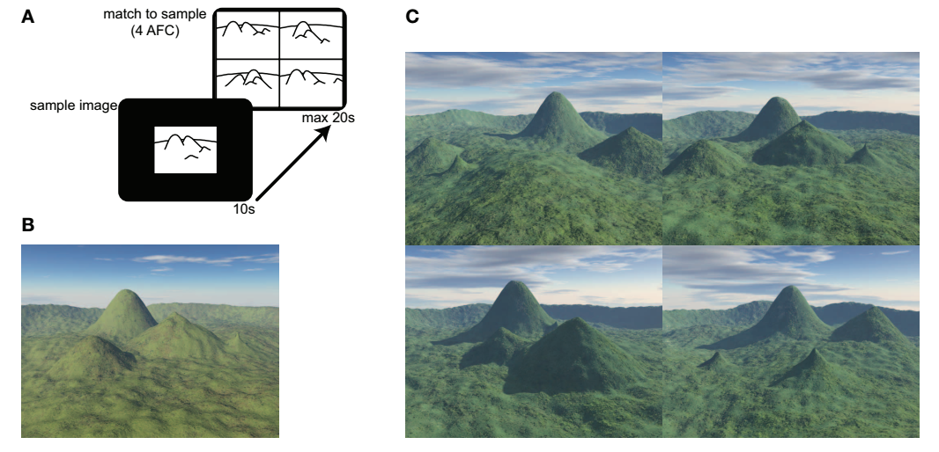
Hartley: Specifically spatial? Undergrads

Slide 15
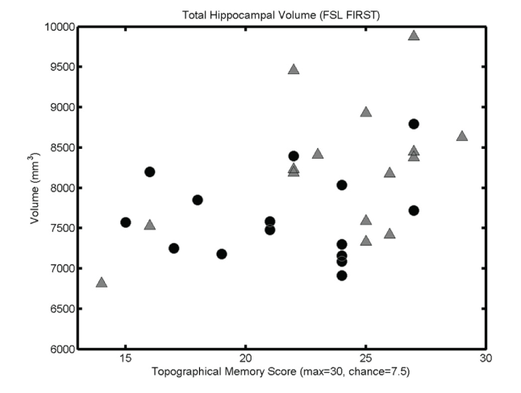
Hartley: Specifically spatial

Slide 16
Study | Corrected * for TBV | Task | Sample | Sample Size | R/L P/A | Effect size
Maguire –PNAS | Y | Taxi driving? | Taxi drivers / Normal controls | 16 taxi 16 age-matched | R/L +P, -A | d = 0.82
Maguire – Hippo | Y | Taxi + bus driving? | Taxi drivers / bus drivers | 18 taxi 17 bus | R +P ,- A | (w/in Taxi): r = .69
Schinazi | N | Real world navigation | Undergrads | 13 | RP | r = .63
Liu | N | SBSOD | Undergrads | 290 | R + L | r_{hpc} = .18
Jenzen | Y | SBSOD | Undergrads | 134 | RA (just male) | n/a
Hartley & Harlow | N | 4 mountains | Undergrads | 30 | RA + LP | r = .40 (R+L)
Bohbot | N | Virtual radial maze | Older adults | 45 | RP | r = .48
Chrastil | Y | Loop task | Undergrads | 26 | R | r = .17 (?)

Slide 17
Study | Corrected * for TBV | Corrected for Age/gender | Left / Right Posterior / Anterior
Maguire –PNAS | Y | N | R/L +P, -A
Maguire – Hippo | Y | N | R +P ,- A
Schinazi | N | N | RP
Liu | N | Y | R + L
Jenzen | Y | Y | RA (just male)
Hartley & Harlow | N | N | RA + LP
Bohbot | N | N | RP
Chrastil | Y | Y | R

Slide 18
Study | N | Scanner | Task | Analysis | Sample | Effect size
Eleanor Maguire | 26 | 2T Siemens Vision | Virtual navigation | VBM + Volumetry | Young and older adults | 0.69
Tom Hartley | 30 | 3T GE Signa Excite | 4 mountains task | VBM + Volumetry | Young adults | 0.4
Victor Schinazi | 13 | 3T Siemens MAGNETOM Trio Tim | Virtual Silcton | VBM + Volumetry | Young adults | 0.63
Denise Head | 92 | 1.5T Siemens Sonata | Virtual wayfinding and route learning task | Volumetry | Young and older adults | 0.49
Megan Herting | 34 | 3T Siemens MAGNETOM Trio Tim | Virtual Morris Water maze | Volumetry | Adolescents | 0.42
Scott Moffat | 68 | 1.5T GE Signa | Virtual Morris Water maze | Volumetry | Young and older adults | 0.38
Simone Kuehn | 91 | 3T Siemens MAGNETOM Trio Tim | Learning a virtual zoo | Volumetry | Young and older adults | 0.46
Veronique Bohbot | 49 | 3T Siemens MAGNETOM Trio Tim | Virtual radial arm maze | Volumetry | Older adults | 0.41

Slide 19
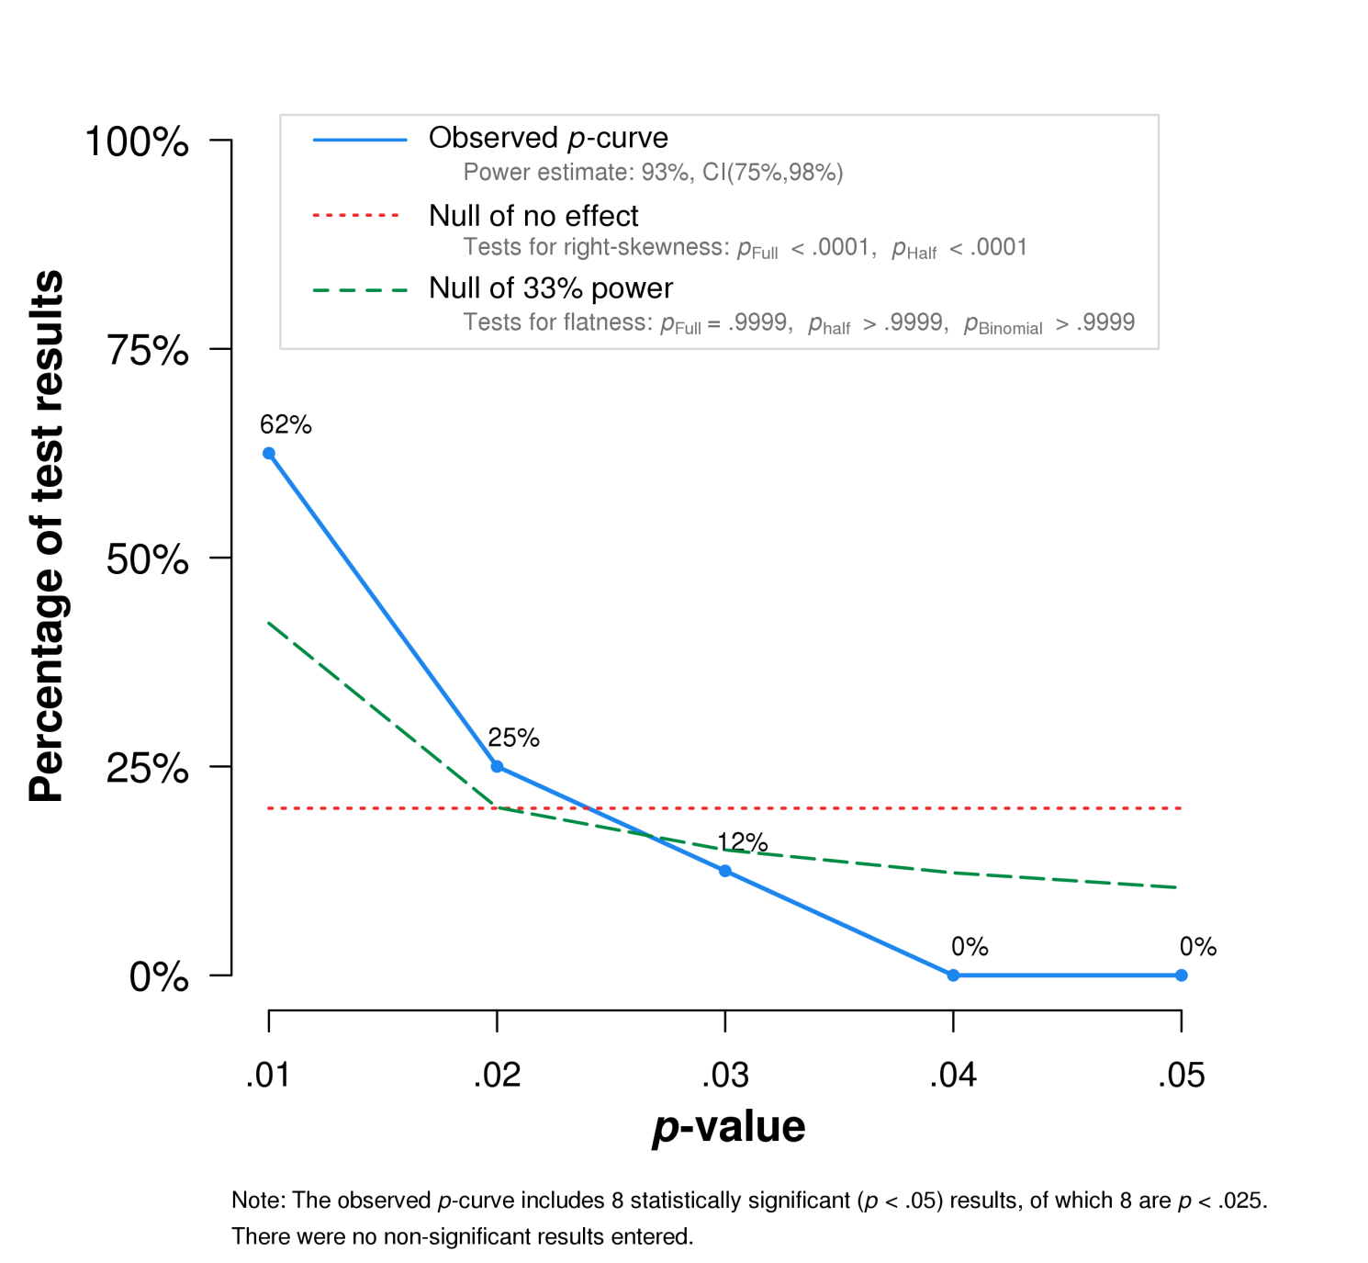
P-Curve: Evidential Value!

Slide 20
Hippocampal Contributions to Human Navigation
General structure-function relation?
Specific structure-function relation?
Levels of analysis….
Single-cell recording: place cells, etc.
Voxel-level: Distance coding
Whole-structure level: Spatial navigation
Lesion studies (Habib & Sirigu; HM)
And size of structure? – WHY?

Slide 21
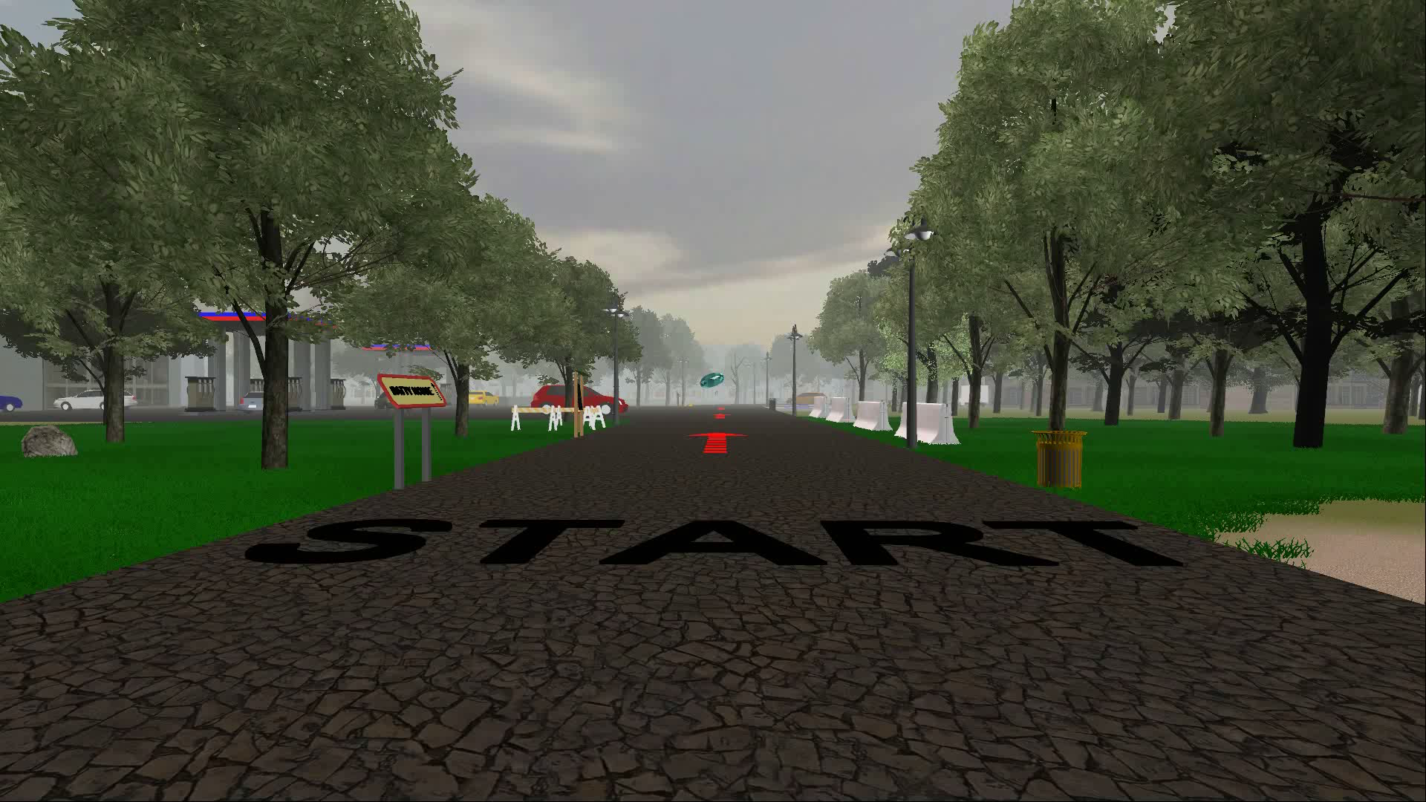
Virtual Silcton (Unity 3d)
Weisberg et al. (2014) JEP:LMC; Weisberg & Newcombe (2016) JEP:LMC
Notes:
MOVIE OF SILCTON

Slide 22
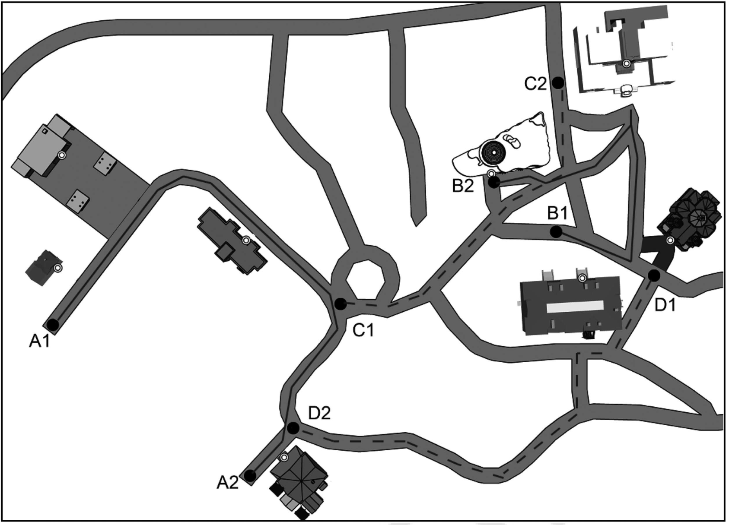
Virtual Silcton
Weisberg et al. (2014) JEP:LMC; Weisberg & Newcombe (2016) JEP:LMC
Notes:
We chose to ground our virtual environment in the real world by modeling it after Temple’s Ambler campus, since we knew it exhibited a pattern of individual differences reliably.
Although virtual environments are not the gold standard of ecological validity that real world navigation is – having limited sensory cues, field of view, etc., the trade-off between a large sample size and ecological validity in this case is worth it.

Slide 23
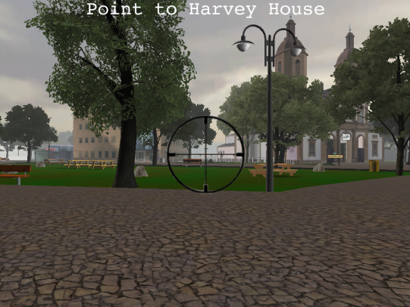
Onsite Pointing
Weisberg et al. (2014) JEP:LMC; Weisberg & Newcombe (2016) JEP:LMC
Notes:
One commonly used task to assess survey knowledge is called a pointing task. In this task, we require participants to point directly at a landmark, and can thus infer whether or not they can take a novel shortcut to that landmark.

Slide 24

Onsite Pointing
Weisberg et al. (2014) JEP:LMC; Weisberg & Newcombe (2016) JEP:LMC
Notes:
Talk about between / within route pointing

Slide 25
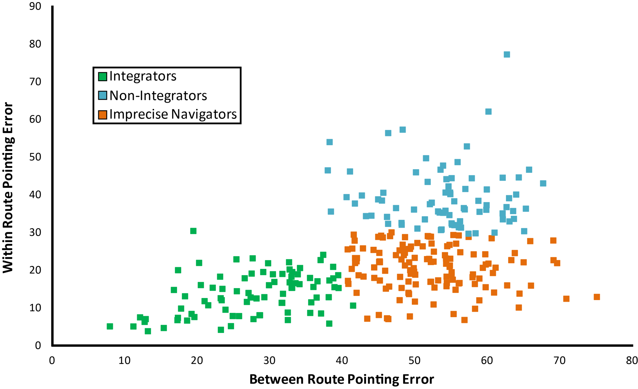
Two dimensions of individual differences
K-means clustering generated 3-group solution.
Integrators
Non-Integrators
Imprecise Navigators
Chance performance = 90°
Weisberg et al. (2014) JEP:LMC; Weisberg & Newcombe (2016) JEP:LMC
Notes:
Mention the cluster analyses

Slide 26
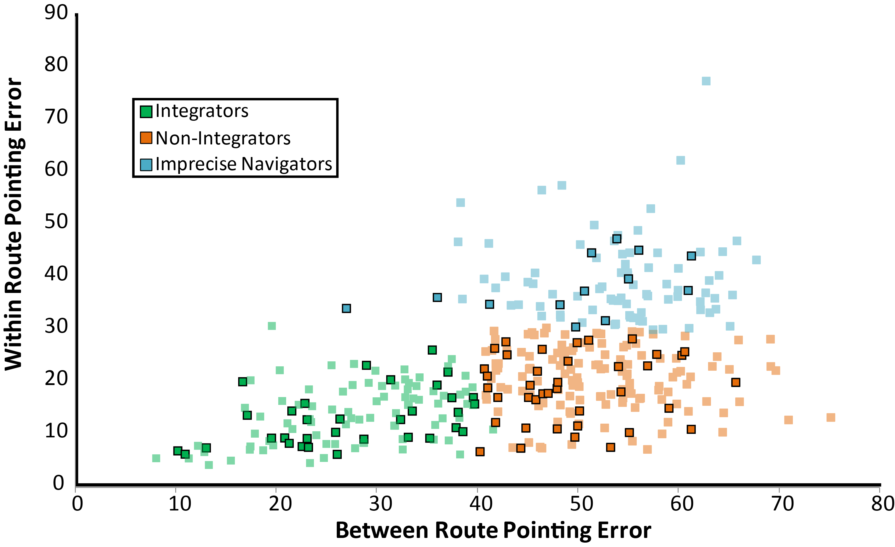

Slide 27
Silcton + MRI?
70 Participants (41 women)
Behavioral measures:
MRT, SBSOD, WRAT (verbal iq, covariate)
Brain measures:
Subcortical, cortical volume
Anterior/Posterior split

Slide 28
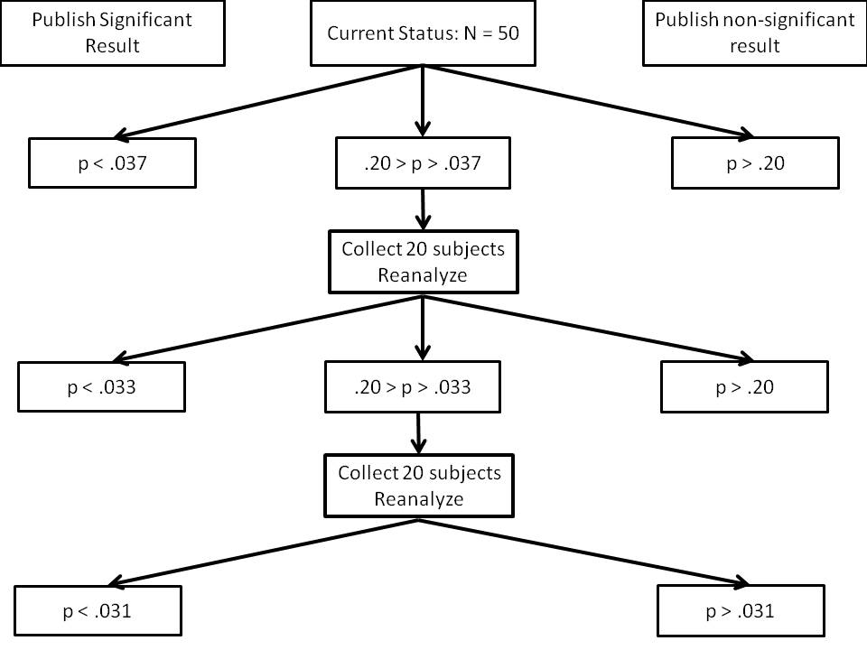
Sequential Analysis (Pre-Reg) RHC

Slide 29
Sequential Analysis (Pre-Reg) RHC

Slide 30
So, what did we learn
The literature is…mixed.
No one has a theory about why.
Are these studies exercises in noise mining?
Well, this one sort of is

Slide 31
Conclusions
Hippocampally-based navigation != navigation
Expert / older adults different from typical variability in a healthy, young sample?
Re-analysis will inform both of these points!

